Slide 1




DatA breach - risk assessment
Final Project by Francesca Mele

Slide 2
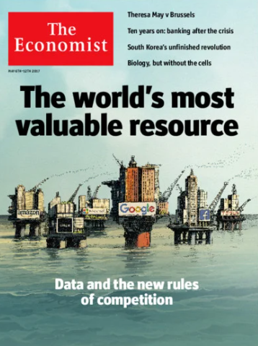
2017 - The big announcement and the giant problem.
How do we dodge a bullet?

Slide 3

Informative choices and road signs: the driver and the investor

Slide 4

PRIVACY RIGHTS CLEARING HOUSE DATASET (2005-2019)
TYPE OF BREACH
CARD Fraud Involving Debit and Credit Cards Not Via Hacking (skimming devices at point-of-service terminals, etc.)
HACK Hacked by an Outside Party or Infected by Malware
INSD Insider (employee, contractor or customer)
PHYS Physical (paper documents that are lost, discarded or stolen)
PORT Portable Device (lost, discarded or stolen laptop, PDA, smartphone, memory stick, CDs, hard drive, data tape, etc.)
STAT Stationary Computer Loss (lost, inappropriately accessed, discarded or stolen computer or server not designed for mobility)
DISC Unintended Disclosure Not Involving Hacking, Intentional Breach or Physical Loss (sensitive information posted publicly, mishandled or sent to the wrong party via publishing online, sending in an email, sending in a mailing or sending via fax)
TYPE OF BUSINESS
BSF Businesses (Financial and Insurance Services)
BSO Businesses (Other)
BSR Businesses (Retail/Merchant including Online Retail)
EDU Educational Institutions
GOV Government & Military
MED Healthcare, Medical Providers and Medical Insurance Services
NGO Non-profits

Slide 5
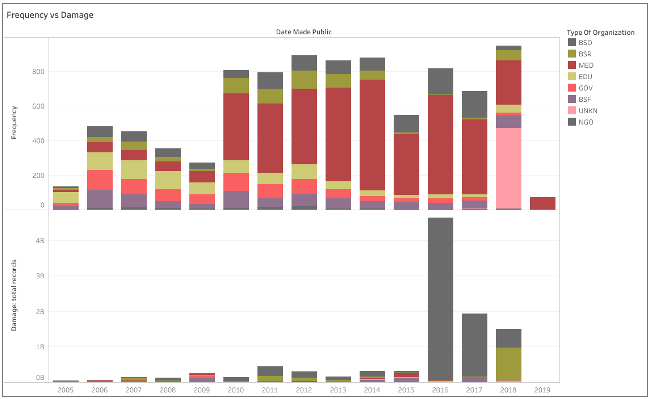
Our Focus is ON Healthcare and Businesses

Slide 6
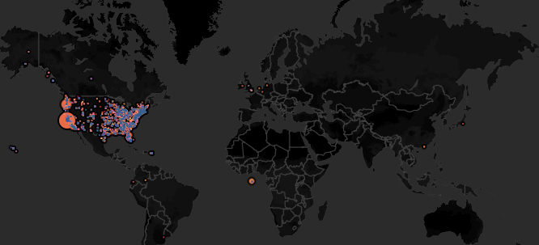
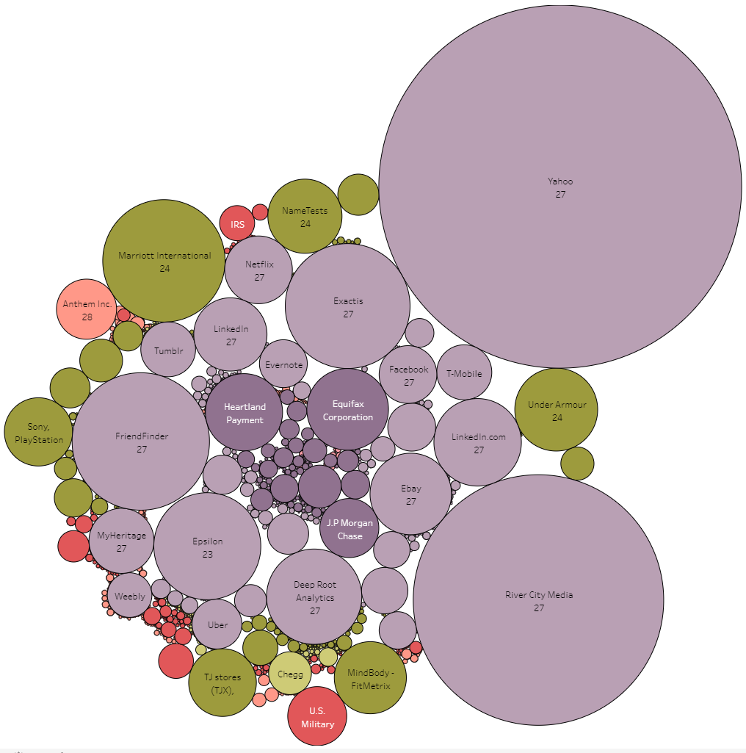
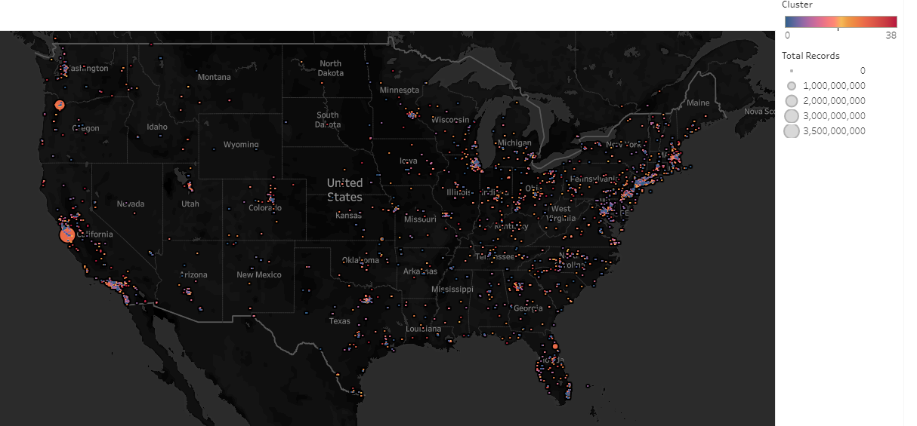
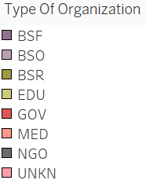
Our Clustering model

Slide 7
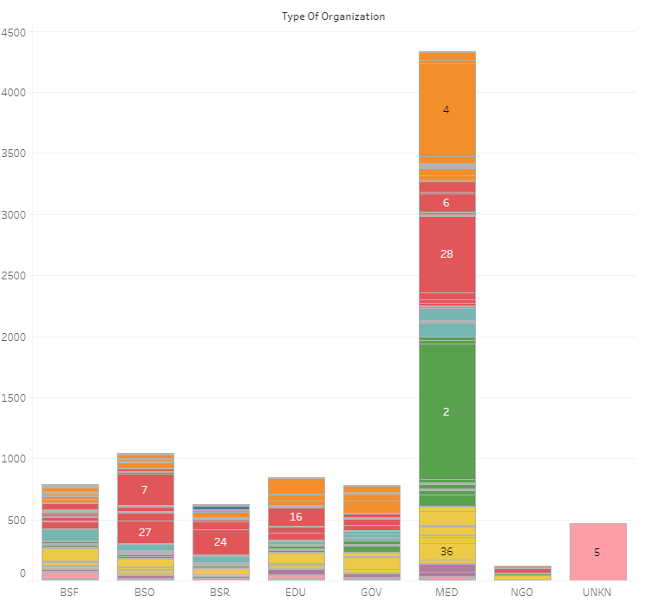
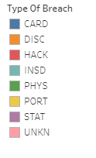
What are the clusters telling us?
Within Healthcare is highly predictable a physical breach for the cluster 2, unvoluntary disclosure for the cluster 4, and hacking for the cluster 28.
The first 2 indicates the need within healthcare in general to make sure the organization performs the right procedures in terms of access from internal or external user to protect from unauthorized ones.
HACKING is a trend in different categories, is dominant and more damaging than all the other type of breaches. Hacking is most likely to happen to Business especially in the cluster 7 and the cluster 27

Slide 8
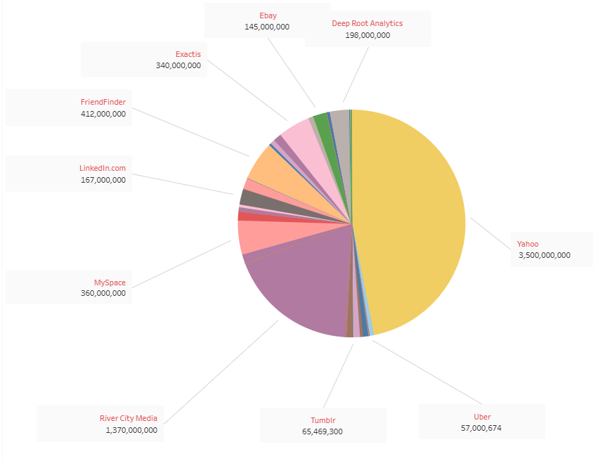
The cluster 27
Yahoo
Ebay
LinkedIn
Uber
MySpace
Tumblr
Wordpress
Tinder
Twitter

Slide 9

How can we improve our analysis?
- Increase accuracy adding more data regarding each company to better profile the segmentation of the exposure risk (what type of security system do they use? How much does each company invest on security each year? Number of employees working in Security?)
- Create a scoring criteria based on clustering to evaluate the strategy to adopt
- Reduce biases for locations getting a better overview on the line of reporting (understand why the most data is located in the United States)

Slide 10

QUESTIONS?
Thank you for the attention

